Slide 1
Lecture 15
'Respect' – as the Right Evaluation

Slide 2
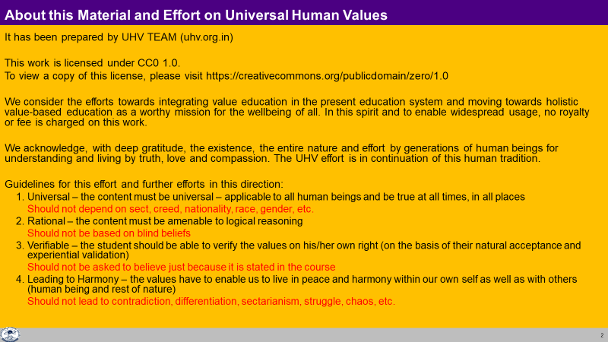

Slide 3
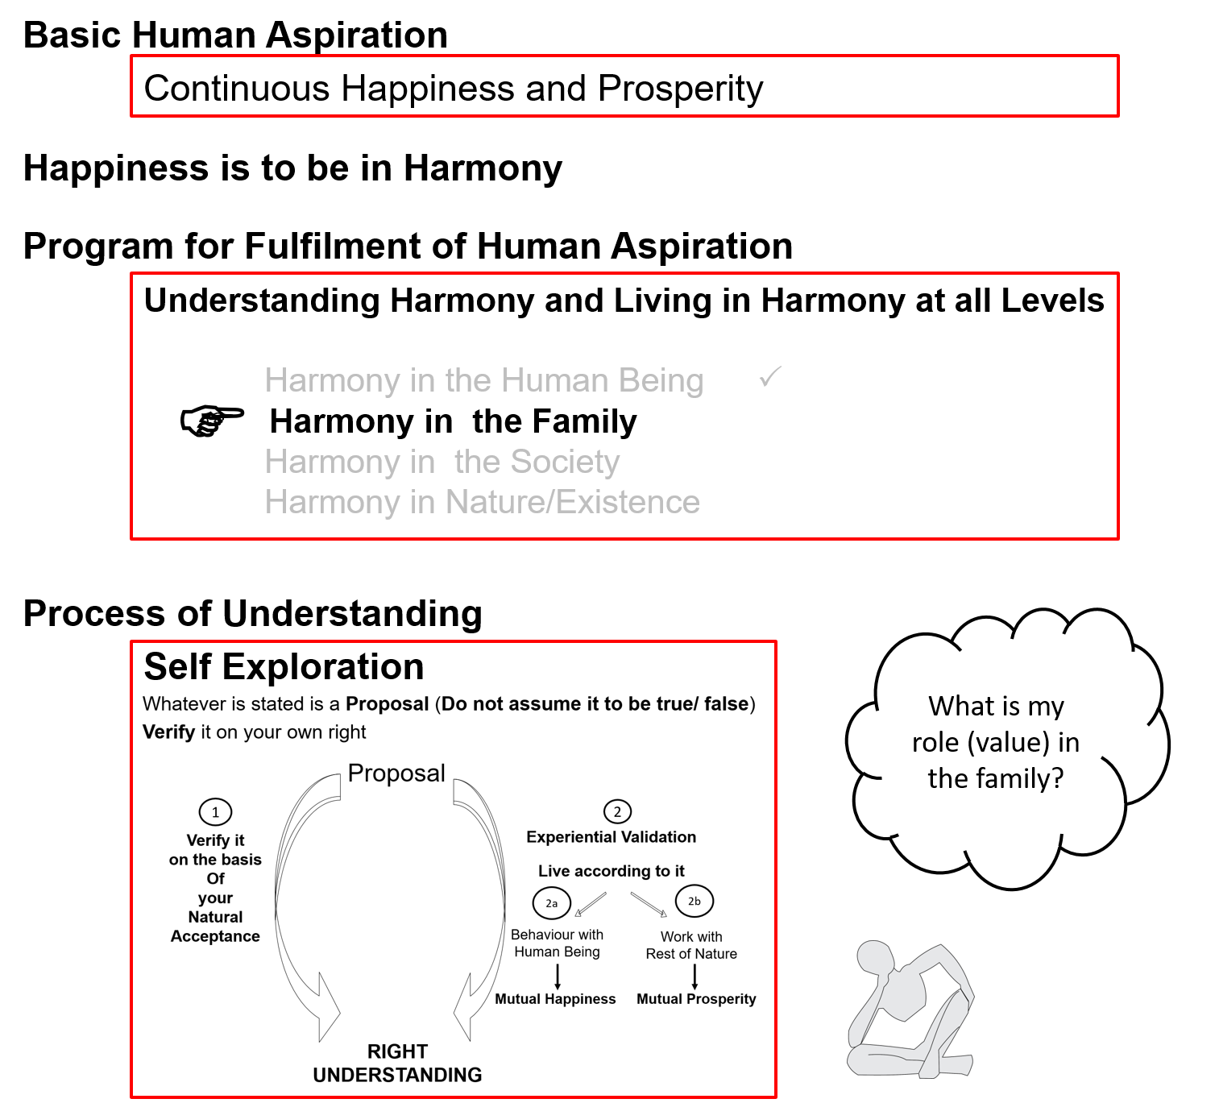
Notes:
This has already been covered before (in L 13), so no need to explain this slide
The feeling to be discussed is mentioned in the first slide – Respect – as Right Evaluation

Slide 4
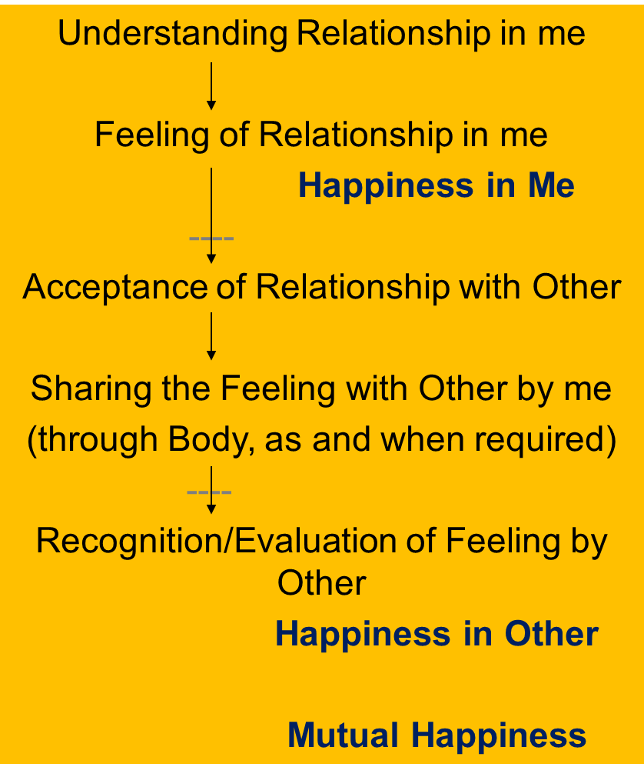
Harmony in the Family
Relationship is – between one self (I₁) and another self (I₂)
There are feelings in relationship – in one self (I₁) for the other self (I₂)
These feelings can be recognized – they are definite (9 Feelings)
Their fulfilment, evaluation leads to mutual happiness
Feelings in relationship:
1- Trust fo”okl FOUNDATION VALUE
2- Respect lEeku
3- Affection Lusg
4- Care eerk
5- Guidance okRlY;
6- Reverence J)k
7- Glory xkSjo
8- Gratitude —rKrk
9- Love izse COMPLETE VALUE
Notes:
Just a recap – no need to elaborate

Slide 5
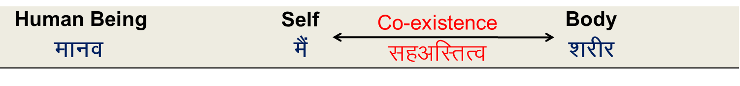
Respect (lEeku)
Respect = Right Evaluation
lEeku ¾ le~ $ eku
lE;d~ ekiuk
Bhd Bhd vkadyu djuk
Explore: Will the right evaluation of a human being be based on the Self or the Body?
Right evaluation based on the Self =
Right evaluation of intention (natural acceptance) and right evaluation of competence…
Notes:
Key point
Respect = Right Evaluation
Right evaluation of human being… the intention (natural acceptance) and competence… ← we will discuss this in detail, so no need to elaborate this here, just a mention is sufficient)

Slide 6

Wrong Evaluation
Over evaluation – to evaluate for more than what it is
vf/kewY;u vf/kd vkaadyu djuk
Under evaluation – to evaluate for less than what it is
voewY;u de vkaadyu djuk
Otherwise evaluation – to evaluate for other than what it is
vewY;u vU;Fkk vkaadyu djuk
Not naturally acceptable. Whenever the evaluation is not right, it is disrespect
Check for yourself in every interaction with others whether it is respect or disrespect. i.e.
  It is right evaluation or
  It is over / under / otherwise evaluation
Disrespect
vieku
Notes:
Key point
Over, under, otherwise evaluation = disrespect
Elaboration
Over evaluation – give small example and move on
Under evaluation – give small example and move on
Otherwise evaluation – give small example and move on
The check for yourself part should be kept to a bare minimum, just to draw attention that it matters
6

Slide 7
Common Implications of Disrespect
Over evaluation – evaluating more than what it is
vf/kewY;u & vf/kd vkaadyu djuk
Right
Evaluation
lEeku
Ego (अहंकार)
Wrong evaluation…
Disharmony within
Tension
Frustration
Depression
Suicide...
Self Confidence
स्वयं में विश्वास
Depression (अवसाद)
Under evaluation – evaluating less than what it is
voewY;u & de vkaadyu djuk
Otherwise evaluation – evaluating other than what it is
vewY;u & vU;Fkk vkaadyu djuk
Notes:
Key point
Disrespect may have serious implications – give few examples of over-evaluation (ego), under evaluation (depression)
Need for right evaluation
7

Slide 8
Respect: Right Evaluation – on the basis of the Self
Purpose y{;
    I want to live with continuous happiness & prosperity
    The other also wants to live with continuous happiness & prosperity
    Our purpose is same (on the basis of Natural Acceptance)
Program dk;ZØe
    My program is to understand and to live in harmony at all levels of being
    The program of the other is also to understand and to live in harmony at all levels of being (Individual, family, society and nature/existence)
    Our program is same
Potential {kerk
    Desire, Thought & Expectation ¼bPNk] fopkj] vk”kk½ is continuous in me. I am endowed with Natural Acceptance
    Desire, Thought & Expectation ¼bPNk] fopkj] vk”kk½ is continuous in the other. The other is also endowed with Natural Acceptance
    Our potential is same
MINIMUM CONTENT of RESPECT
The Other is Similar to Me nwljk esjs tSlk gS
MINIMUM CONTENT of RESPECT
Notes:
Key Point
The other is similar to me
Elaboration
We have the same purpose
We have the same program
We have the same potential

Slide 9
Sum Up
Respect is right evaluation
= right evaluation of intention (natural acceptance) and right evaluation of competence
(competence is the portion of imagination that is guided by natural acceptance)
Under evaluation, over evaluation or otherwise evaluation is disrespect
The purpose, program and potential to develop are the same for all human beings
– in that sense, all human beings are similar
The minimum content of respect is to be able to see the other as a human being who is similar to me
We will now explore into the complete content of respect…

Slide 10
Self Reflection
in our day-to-day living:
Do we accept the other as being similar to us?
or
We try to show that we are special, unique, different from the other?
Notes:
This is an important question
“If we are similar, why do we try to show we are special, unique, different?”, “why do we differentiate?”
Let participants explore
Next we will see some examples of how we differentite

Slide 11
Differentiation Hksn
Differentiation
Hksn
Body
“kjhj
Age
vk;q
Gender
fyax
Race
oa”k
Physical
Strength
cy
The Gross Misunderstanding is
“Human Being = Body”
While the reality is
“Human Being is co-existence of Self & Body”
Notes:
Key point
We have to understand the reality human being as it is
(otherwise we continue to differentiate)
11

Slide 12
Differentiation Hksn
Differentiation
Hksn
Physical Facility
lqfo/kk
Wealth
/ku
Post
in
The Gross Misunderstanding is
“Physical Facility = Happiness”
While the reality is
“Happiness is being in a state of Harmony”
Notes:
Key point
We have to understand the reality happiness
(otherwise we continue to differentiate)
12

Slide 13
Differentiation Hksn
Differentiation
Hksn
Beliefs
ekU;rk
Isms okn
Sects
laiznk;
Info
lwpuk
The Gross Misunderstanding is
“If the pre-conditioning of the other matches
my preconditioning, then the other is like me”
While the reality is
“Every Human Being is like me”
Notes:
Key point
We have to understand our Natural acceptance (the core of our sameness)
(otherwise we continue to differentiate)
13

Slide 14
Differentiation Hksn
Differentiation
Hksn
Differentiation = Disrespect
Not Naturally Acceptable… Opposition, Movements…
Hksn ¾ vieku
lgt Lohdk;Z ugha gksrk--- fojks/k--- vkUnksyu---
Body
“kjhj
Physical Facility
lqfo/kk
Beliefs
ekU;rk
Age
vk;q
Gender
fyax
Race
oa”k
Physical
Strength
cy
Wealth
/ku
Post
in
Isms okn
Sects
laiznk;
Info
lwpuk
Notes:
Key Point
We want respect, not domination
Differentiation = Disrespect
It is not naturally acceptable
It has led to so much oppositions, movements
Examples
Black-white movement, feminist movement…
Struggles between rich and poor
14

Slide 15
Recalling: Minimum Content of Respect – The Other is Similar to Me
Purpose y{;
    I want to live with continuous happiness & prosperity
    The other also wants to live with continuous happiness & prosperity
    Our purpose is same (on the basis of Natural Acceptance)
Program dk;ZØe
    My program is to understand and to live in harmony at all levels of being
    The program of the other is also to understand and to live in harmony at all levels of being (Individual, family, society and nature/existence)
    Our program is same
Potential {kerk
    Desire, Thought & Expectation ¼bPNk] fopkj] vk”kk½ is continuous in me. I am endowed with Natural Acceptance
    Desire, Thought & Expectation ¼bPNk] fopkj] vk”kk½ is continuous in the other. The other is also endowed with Natural Acceptance
    Our potential is same
MINIMUM CONTENT of RESPECT
The Other is Similar to Me nwljk esjs tSlk gS
MINIMUM CONTENT of RESPECT
Notes:
Key Point
The other is similar to me
Elaboration
We have the same purpose
We have the same program
We have the same potential

Slide 16
Respect: The Other is Similar to Me. We are complementary to each other
1. Purpose – Our purpose (Natural Acceptance) is same
2. Program – Our program is same
3. Potential – Our potential is same
The Other is Similar to Me
4. Competence – On the basis of right evaluation of our mutual competence, I recognise our complementarity and fulfill it:
  If the other has more understanding, is more responsible than me
      I am committed to understand from the other
  If I have more understanding, I am more responsible than the other
      I live with responsibility with the other, unconditionally, unperturbed by the behaviour of the other
      I am committed to facilitate understanding in the other (once the other is assured in relationship, and not before that)
COMPLETE CONTENT of RESPECT
The Other is Similar to Me. We are complementary to each other
COMPLETE CONTENT of RESPECT

Slide 17

What is your Natural Acceptance?
To be complimentary to the other?
or
To use the difference in competence to compete, differentiate, discriminate, dominate?
Natural Acceptance
To be complimentary to the other
Preconditioning
I am special, unique, different from the other
Notes:
Key point
Differentiation is due to our assumptions, preconditioning
e.g., “I am special, unique, different from the other”
Preconditioning is in the Self
We can check our own preconditioning
But are there any other differences at the level of the Self – Let us explore this question now

Slide 18
Complementarity
To complement one another, we need to rightly evaluate each other’s competence and skills
  Right evaluation of competence = Right evaluation of level of understanding, right feeling and right thought, clarity of what to do
  Right evaluation of skills = Right assessment of ability to perform a certain task, ability of how to do a certain task
Competence and skills are complimentary
Of course, competence plays a more significant role in our complementarity
Also:
  Greater the competence, a larger share of imagination is guided by right understanding, leading to right feeling and greater harmony in thought and selecting
  With more competence, one can more easily learn relevant skills and rightly use the skills
Self 1
Self 2
imagination guided by right understanding
Less competent
More competent
Notes:
Discussion Points:
FAQ: What about evaluation of skill?
Where would you place the skill of making a chair… making a bomb…

Slide 19
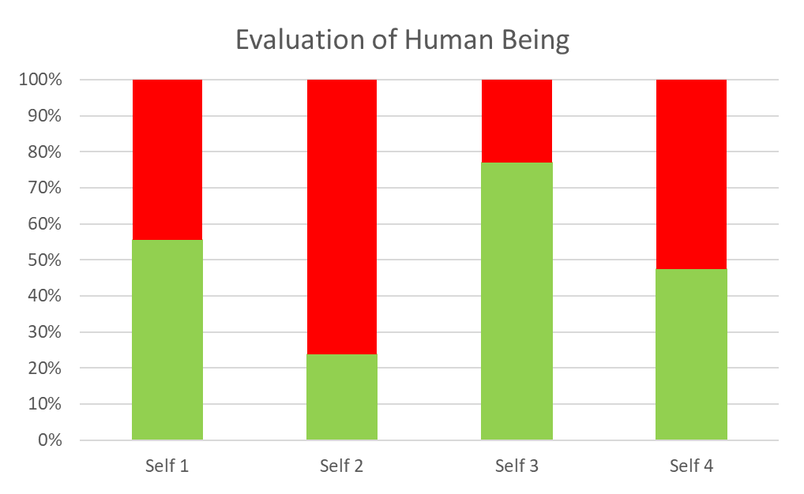
Right Evaluation, Feeling of Complimentarity
Intention (natural acceptance) is
same for all
Purpose,
Program and
Potential
Same for all
Competence of various people may be quite different
Respect = Right evaluation
(of intention and competence)
Lack of Competence
Competence
Me (Self₁) Self_{i} Self_{j} Self_{k}
Take-away:
The feeling of Complementarity
The Other is Similar to Me. We are complementary to each other
With the feeling of complementarity, other feelings naturally follow

Slide 20
Expression of Respect – Complementariness
a person with more understanding will be more responsible in relationship, help those with less understanding to develop
A person with less understanding will seek out those with more understanding and take their help
a person with greater physical strength will choose to do the heavy work
a person at a higher post will be more responsible, will coordinate to ensure more harmony in the larger order, for the development of the people in his/her circle of influence…
All the specific characteristics at the level of self and body, as well as available physical facility will be used to express that complementarity
With the feeling of complementariness, other feelings naturally follow

Slide 21
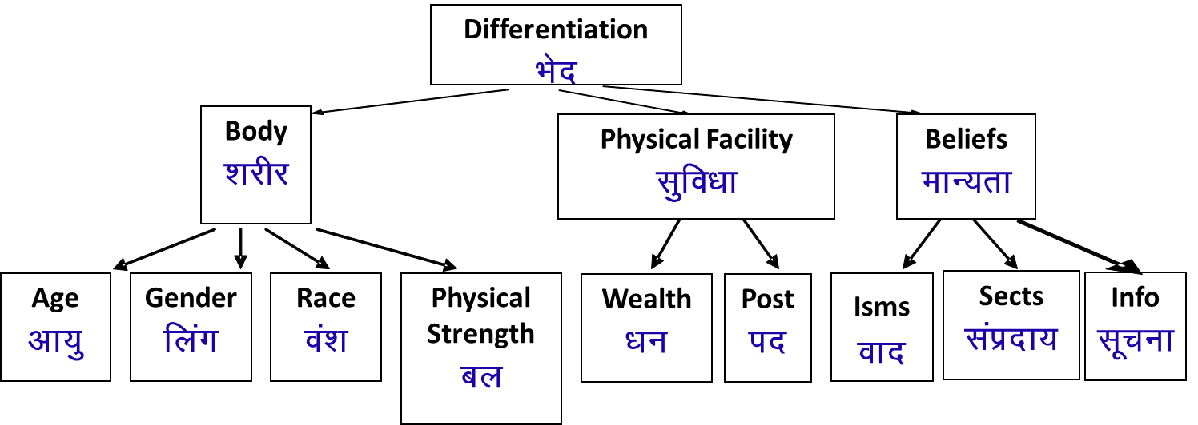
Differentiation Respect – on the basis of Self
I evaluate on the basis of body, physical facility or belief (preconditioning). I compare, compete, differentiate…
I am different from the other
We are competitors
I make effort to accentuate the difference, to manipulate, exploit the other
1. Our purpose (Natural Acceptance) is same
2. Our program is same
3. Our potential is same
The other is similar to me
We are complementary to each other
If the other has more understanding than me
- I am committed to understand from the other
If I have more understanding
1. I live with responsibility with the other
2. I am committed to facilitate understanding in the other (once the other is assured in relationship, and not before that)

Slide 22
Sum Up
Respect is right evaluation
= right evaluation of intention (natural acceptance) and right evaluation of competence
(competence is the portion of imagination that is guided by natural acceptance)
Under evaluation, over evaluation or otherwise evaluation is disrespect
Respect (on the basis of Self) – The other is like me, we are complementary to each other
The only difference is in our level of understanding (how much of our desire, thought and expectation is on the basis of our Natural Acceptance)
  If the other has more understanding, he is more responsible than me
      I am committed to understand from the other
  If I have more understanding, I am more responsible than the other
      I live with responsibility with the other, unconditionally, unperturbed by the behaviour of the other
      I am committed to facilitate understanding in the other (once the other is assured in relationship, and not before that)

Slide 23
Self Reflection

Slide 24
Self Reflection
Reflect on the members of your family (or your friends)
Does each person have a different level of competence?
Check if you do the right evaluation, over-evaluation, under-evaluation or otherwise-evaluation of their competence
Are you also evaluating yourself?
Is your own evaluation the right evaluation, over evaluation, or otherwise evaluation?
Do you see them as similar to you or do you feel you are different from them?
If yes, in what respect do you feel you are different? How do you feel about these differences?
Are you complimentary to them?
How can you be more complimentary to them? i.e., with these different levels of competence, what program can you make to ensure complementariness with every member of the family?

Slide 25
Key Points
Lecture 15: 'Respect' – as the Right Evaluation

Slide 27
Harmony in the Family
Relationship is – between one self (I₁) and another self (I₂)
There are feelings in relationship – in one self (I₁) for the other self (I₂)
These feelings can be recognized – they are definite (9 Feelings)
Their fulfilment, evaluation leads to mutual happiness
Feelings in relationship:
1- Trust fo”okl FOUNDATION VALUE
2- Respect lEeku
3- Affection Lusg
4- Care eerk
5- Guidance okRlY;
6- Reverence J)k
7- Glory xkSjo
8- Gratitude —rKrk
9- Love izse COMPLETE VALUE

Slide 28
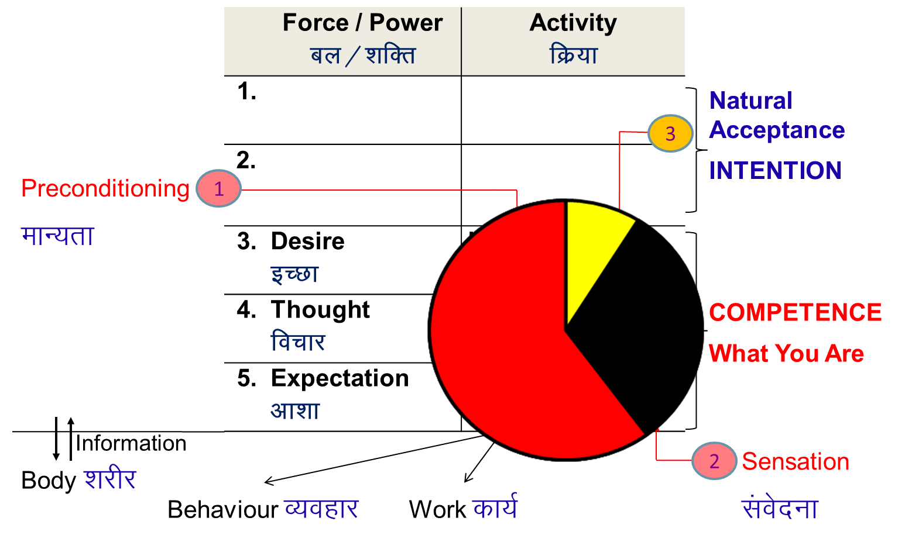
Respect (lEeku)
Respect = Right Evaluation
lEeku ¾ le~ $ eku
lE;d~ ekiuk
Bhd Bhd vkadyu djuk
Right evaluation of human being… the intention (natural acceptance) and competence…

Slide 29
Other Types of Evaluation
Over evaluation – to evaluate for more than what it is
vf/kewY;u vf/kd vkaadyu djuk
Under evaluation – to evaluate for less than what it is
voewY;u de vkaadyu djuk
Otherwise evaluation – to evaluate for other than what it is
vewY;u vU;Fkk vkaadyu djuk
Whenever the evaluation is not right, it is disrespect
Check for yourself in every interaction with others whether it is respect or disrespect. i.e.
  It is right evaluation or
  It is over / under / otherwise evaluation
Disrespect
vieku
Notes:
29

Slide 30
Differentiation Respect – on the basis of Self
I evaluate on the basis of body, physical facility or belief (preconditioning). I compare, compete, differentiate…
I am different from the other
We are competitors
I make effort to accentuate the difference, to manipulate, exploit the other
1. Our purpose (Natural Acceptance) is same
2. Our program is same
3. Our potential is same
The other is similar to me
We are complementary to each other
If the other has more understanding than me
- I am committed to understand from the other
If I have more understanding
1. I live with responsibility with the other
2. I am committed to facilitate understanding in the other (once the other is assured in relationship, and not before that)

Slide 31
Sum Up
Respect = Right Evaluation (with a feeling of trust on intention)
Under evaluation, over evaluation or otherwise evaluation is disrespect
Differentiation is disrespect
Respect (on the basis of Self) – The other is like me, we are complementary to each other
The only difference is in our level of understanding (how much of our desire, thought and expectation is on the basis of our Natural Acceptance)
  If the other has more understanding, he is more responsible than me
      I am committed to understand from the other
  If I have more understanding, I am more responsible than the other
      I live with responsibility with the other, unconditionally, unperturbed by the behaviour of the other
      I am committed to facilitate understanding in the other (once the other is assured in relationship, and not before that)

Slide 32
FAQs for Lecture 15
'Respect' – as the Right Evaluation

Slide 33
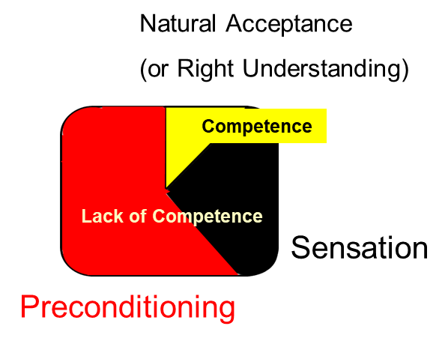
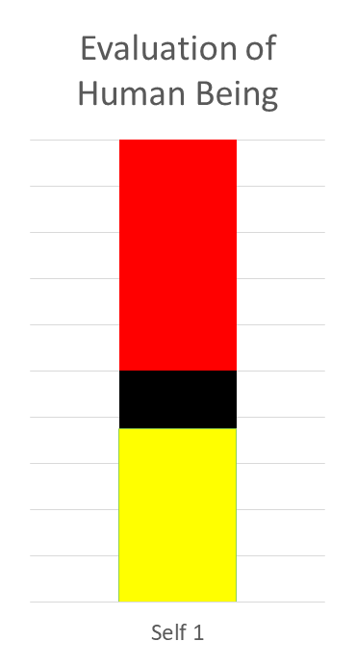
Respect and Disrespect
Over, Under or Otherwise Evaluation is Disrespect.
Competence is the share of imagination
guided by Natural Acceptance
(or Right Understanding)
Lack of Competence
Over Evaluation
(Disrespect)
Right Evaluation (Respect)
Under Evaluation
(Disrespect)
Competence
Otherwise Evaluation (Disrespect)
e.g. Assuming Self = Body
Notes:
Discussion Points:
FAQ: What about evaluation of skill?
Where would you place the skill of making a chair… making a bomb…

Slide 34
Question(s): Response
Today we respect good people but not bad people, like criminals. One person is successful on the basis of his hard work – he has done his PhD, has a good job… Another person is a loser… So, how can we respect both of these people equally?
What we are saying is that at the level of purpose, program and potential, we are similar. However, at the level of competence, we may be different. The difference that is being mentioned here is about the competence and that is fine. The main question is whether we are able to accept that at the level of purpose, program and potential, we are similar or not.
Study level Competence for harmony in
High school Family
Inter Village
Graduation District, State
PG Nation
PhD World

Slide 35
Question(s): Response
When you say right evaluation, what exactly are we evaluating? We generally evaluate the skills to do something, like skill to solve maths problems, etc.
Is the evaluation relative (between one person and another person) or something absolute?
We are evaluating-
1. the purpose, program and potential - similar
and
2. the competence- may be different.
(the competence includes skills)
Evaluation of purpose, program and potential, (which are similar) is absolute
[definite, basic reference – full human potential]
and
Evaluation of competence is wrt potential which is absolute
Competence of two persons may be different hence, they can be compared
However, this comparison is for mutual complementarity and not for differentiation or discrimination

Slide 36
Basic Reference: Full Human Potential (Same for All)
Completeness of understanding (Truth) and feeling (Love)
    Self… entire existence
    My relationship, my role in existence
Completeness of expression (compassion)
    Behavioral competence, ability to live in relationship
    Competence to work or skills related to work
    Competence for participation in the larger order
Check:
Are we able to see that every human being (Self) has the same potential?

Slide 37
Competence
Competence = Accumulated imagination (desire, thought and expectation)…
(skill is a part of competence, not all of it)
Right evaluation of competence
evaluation of how much of the imagination is motivated by natural acceptance
It includes evaluation of the skills related to work
Competence includes (make column for full human potential)
Level of understanding and feeling
Behavioral competence, ability to live in relationship (feeling, likeability, teamwork…)
Competence to work or skills related to work
Competence for participation in the larger order

Slide 38
Value Competence
Skill Proficiency
Values help us decide “what to do”
Value competence can be indicated by the % share of imagination that is guided by Natural Acceptance (which is for relationship, harmony and co-existence)
Having value competence means that we know what to do to ensure harmony at any moment in every situation
To ensure the implementation skill proficiency is also required
Skills help us in “how to do”
Skill Proficiency can be indicated by how well someone can perform a particular task
Having skill proficiency does ensure that the skill will be used for ensuring harmony – for that value competence is a pre-requisite
Values, value competence and skills, skill proficiency are complimentary to each other
Both are required to live with fulfilment

Slide 39
Question(s): Response
How do I ensure right evaluation? How do I know that my evaluation is right?
As mentioned just now, if we are making the evaluation of purpose, program and potential, which are similar, and also competence which may be different (for defining mutual complementarity), then it is a right evaluation. On the other hand, if we are making the evaluation of competence only and on the basis of that differentiate among people, then it is not a right evaluation
Our evaluation is right when
1.We are able to accept the other as being similar
2. We are able to define our complimentarity (at level of competence)
Our interactions lead to mutual development, mutual happiness

Slide 40
Question(s): Response
We have given everything for these students, but they are so spoilt – they don’t respect us at all! I mean they don’t even say good morning or respond when I wish them! How to deal with this much of disrespect?
The problem is that we are not developing the competence of behaviour in the students, we are only focussing on some aspects of competence related to skills of work. This, in fact, is the problem of the whole education system today. As we have been mentioning, right from the first session that right understanding and relationship are also important, rather more important than physical facility, but, our education is only focussed around physical facility and this is the result. The teachers who have tried to work on the first two, have found that the students not only start responding to them, but they respect these teachers, even touch their feet.
Competence includes
Level of understanding and feeling
Behavioral competence, ability to live in relationship (feeling, likeability, teamwork…)
Competence to work or skills related to work
Competence for participation in the larger order

Slide 41
Question(s): Response
Small children often don’t know, so we have to impose (rather than propose). Is that wrong?
We will see in detail about the process of education, when we discuss about the harmony in society and the systems which ensures this, education system being one of them. We have to facilitate (not impose) the students in different ways depending on their age and self development- such as imitation, following, discipline and self-discipline. In all this, there is facilitation and not imposition. In case if self-discipline, it is essential to initiate the process of self-exploration through placing the right proposals.
To be updated
1. Facilitation
2. Keep space for self-exploration…

Slide 42
Question(s): Response
I am doing so much work at home (looking after my child also) and I am working outside the home also. Inspite of this, if my husband doesn’t respect me, my mother in law doesn’t respect me, wont I feel bad? How will I feel like respecting them?
You are saying don’t differentiate. How can my behaviour be the same for all. Like with by boss and sweeper?
Certainly, you will feel bad. But, then how do you respond to this? By disrespecting them, will it work? It is clear that they themselves are in crisis, they do not have right feelings in them and that is why they are not able to share it with you. So you have to help them develop these feelings. In order to do this, you have to ensure right understanding and right feelings in yourself. With this you will be able to create assurance in them with your consistent behaviour and that will create a space for a dialogue This has been discussed before in detail.
Treat them as similar to you at the level of purpose, program and potential. Define your complementarity at the level of their competence. This will significantly change your behaviour with them, IIIT Hyd Example

Slide 43
Question(s): Response
To motivate me, my mother used to say “you are different, you are special – you can do anything”. My father never appreciated me. Even when I did well at school, he would just say “Good. Do better next time”.
Now that I am teaching, I tell my good students “you can do anything”, “sky is the limit”. And for the poor students, I say “if you don’t improve, you will have to work in the farm”. Both are to motivate them to do better.
Now I can see that these are like an over evaluation or even otherwise evaluation! So, what would be the right way of appreciating and motivating my students?
Every human being has a natural acceptance for understanding what is right and doing what is right. So, we must take this as the basis for appreciating and motivating students. But, one thing is important, to do this, first we have to establish an assurance in relationship with them. Then, they will be willing to listen to us, and take our guidance.

Slide 44
Clarity of potential (“full human potential”)
Appreciation for the part completed
Motivation for the part yet to be completed

Slide 45
Appreciation and Motivation
There is clarity of potential (“full human potential”), the basic aspiration (human goal) is clear, the completion point is clear (3). This potential is always at the base of any interaction with the other
Past state at (1) is evaluated rightly
Present state (2) is also evaluated rightly
(3)-Full Potential
Motivation for the part yet to be completed (2 to 3)
  At least one specific action point for the immediate next step for this development is shared
(2)-Present State
Appreciation for the part completed
(1 → 2 has been achieved in some given time)
(1)-Past State

Slide 46
Question(s): Response
Please give some examples of otherwise evaluation. It is not very clear to me
When someone under-evaluates me, I do feel bad. But when they praise me, I feel good. Don’t you think that saying that these things lead to depression or ego is too much? And suicide! Can you give some example or explain in more detail?
When you are very unhappy with your child, you say he is a donkey. This is otherwise evaluation for your son and your own self.
How do you feel when somebody says- he can do anything. Do you feel comfortable or uncomfortable within, you certainly get disturbed within, observe it. One thing is very clear that when someone over-evaluates you, it is like to enhance your ego; and as we said depression is an outcome of this over-evaluation when you are not able to perform as per this- “those who feel punctured, must have been a bubble”.
Example of suicide at IIT Kanpur by a 10 pointer!

Slide 47
Question(s): Response
I can see it is important to understand and help others to understand. How would I know if the other has more understanding than me or less understanding than me?
If we both don’t have right understanding, then what should we do?
One indicator of right understanding is that my competence is in line with my natural acceptance, which essentially means that I am in a state of harmony within, a state of happiness within.
The other indicator is that my behaviour and my work is mutually fulfilling for others.
So, on the basis of these two indicators, we can make an estimate as to what extent one is able to develop his understanding. This can be the basis of my deciding whether the other has more understanding than me or less.
Generally, we take the attitude “I am OK, the problem is with the other”

Slide 48
Question(s): Response
If my boss asks me do something unethical then how do I define my complimentarity with him?
In a just societal system, we define our participation in the system based on our competence. Someone with higher competence is given the responsibility to guide or coordinate those with lower competence. In that case, we can define our complemenarity by taking the guidance from him or working under his coordination.
In this case, the responsibility of coordination is given to someone who is asking me do something unethical, this indicates that he does not have the necessary competence to guide. So, first thing that is required is to help to improve his competence so that he can be a good guide or coordinator. For this you have to work out the way.
Example of air force technical staff...

